Slide 1

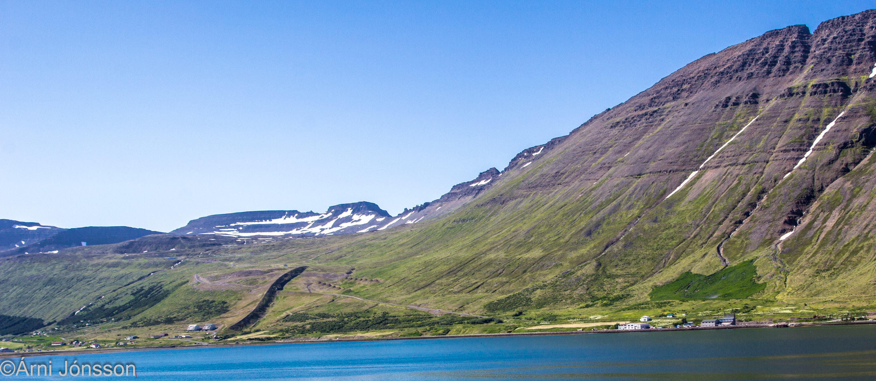
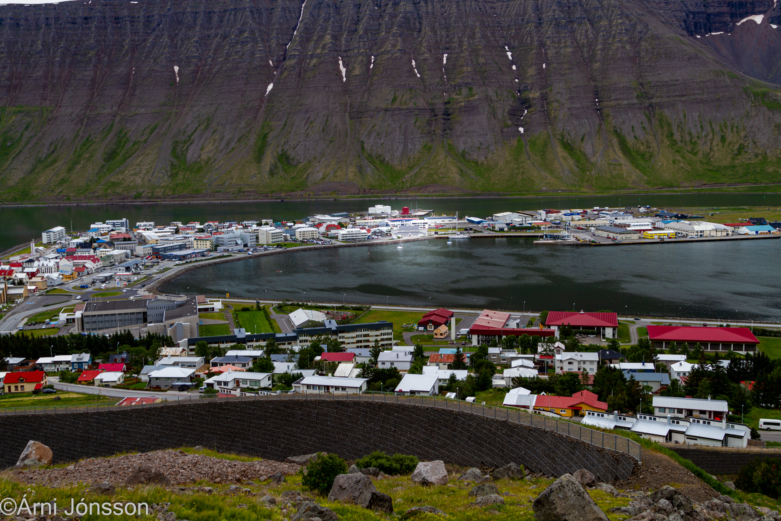
Title of your poster presentation (DIN A0)
Name Firstauthor¹, Name Secondauthor² and Third Lastauthor¹
¹ Name and address of associated institution 1
² Name and address of associated institution 2
Introduction
Your poster should communicate your research and findings in a well structured, understandable and appealing manner. This way you can maximize the attractiveness of your contribution and capture the interest of the conference attendees.
This template intends to support you in the preparation of your poster presentation. It sets guidelines for a more standardized appearance of all the contributions in order to make it easier for the public to perceive the information.
Figure 1: Mitigation measures in Ísafjörður by Snow2025.
Content & Structure
Try to structure your poster along a reading path from top left to bottom right
Keep the poster background in light colors to increase the readability
Don‘t use too many colors, it‘s difficult to read
Illustrations should be used to increase the attractiveness and understandability of the content. Their size should be close to A4
Icons and thumbnails help to structure the reading
A short conclusion is important for the reader and should provide a concise take-away message
Text formatting, Dos & Don'ts
Font: use Arial Black for the title and Arial for the rest
Size:
  Title & Subtitle between 60 and 80 pts
  Headers between 40 and 60 pts
  Text body between 32 and 40 pts
  Captions not smaller than 24 pts
Try to avoid CAPITILIZED writing
Make simple and short sentences and try to keep the overall amount of text to a minimum.
Captions should attract the readers attention!
Figure 2: The conference centre in Ísafjörður in the middle.
Outlook
A poster presentation is a great way of communicating your research to the international snow and avalanche community. By keeping the poster structured and simple and following some basic rules, every contribution has the power to shine!
Place for logos

