Slide 1
Title of your presentation
Presenting Author
Name and address of associated institution no. 1
Name and address of associated institution no. 2

Slide 2
Guidelines
We recommend format 16:9
Make the presentation simple and precise
Use high-quality graphs and charts
Same font preferable in presentation, font size 20 points or larger
General oral presentations: 12+2 min., Keynote oral presentations: 26+3 min

Slide 3
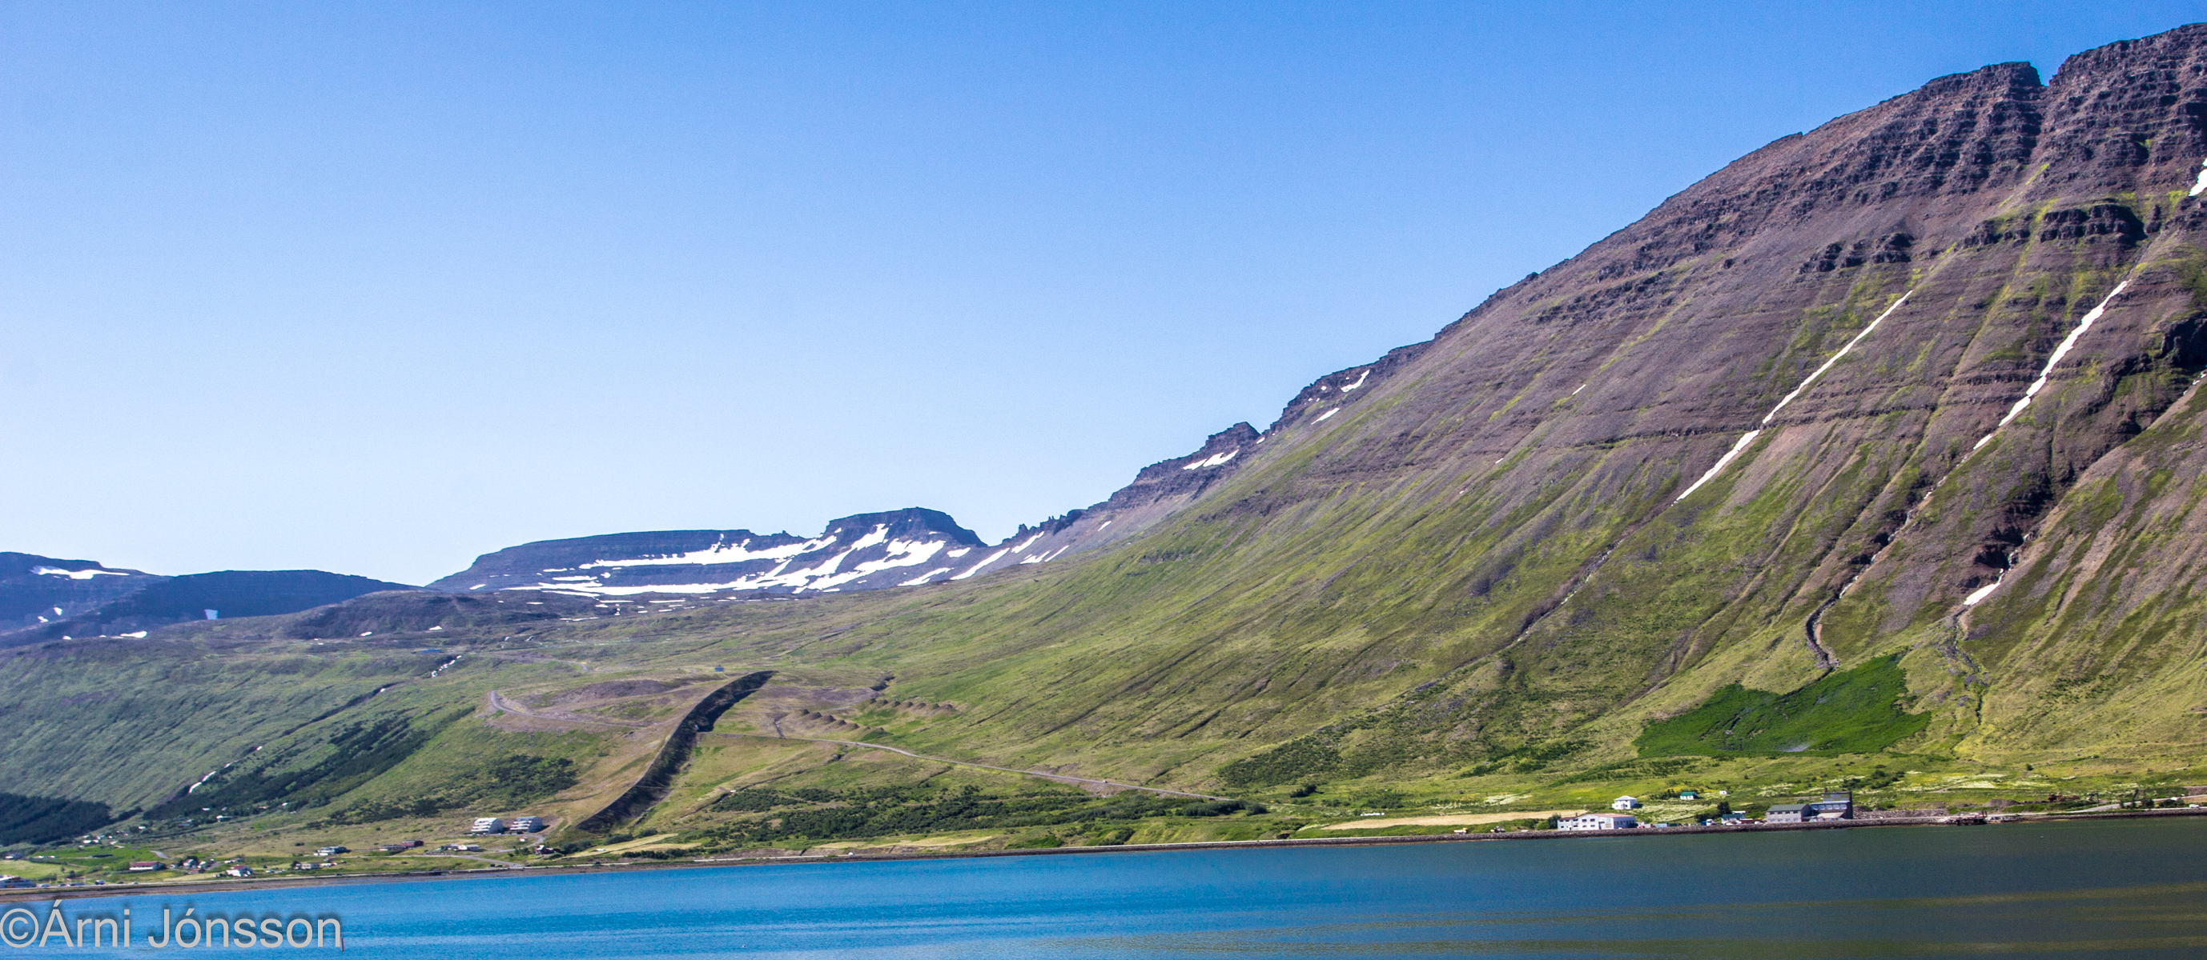
“Snow 2025”
We welcome you to an exciting symposium in spectacular Northwest Iceland

